Slide 1
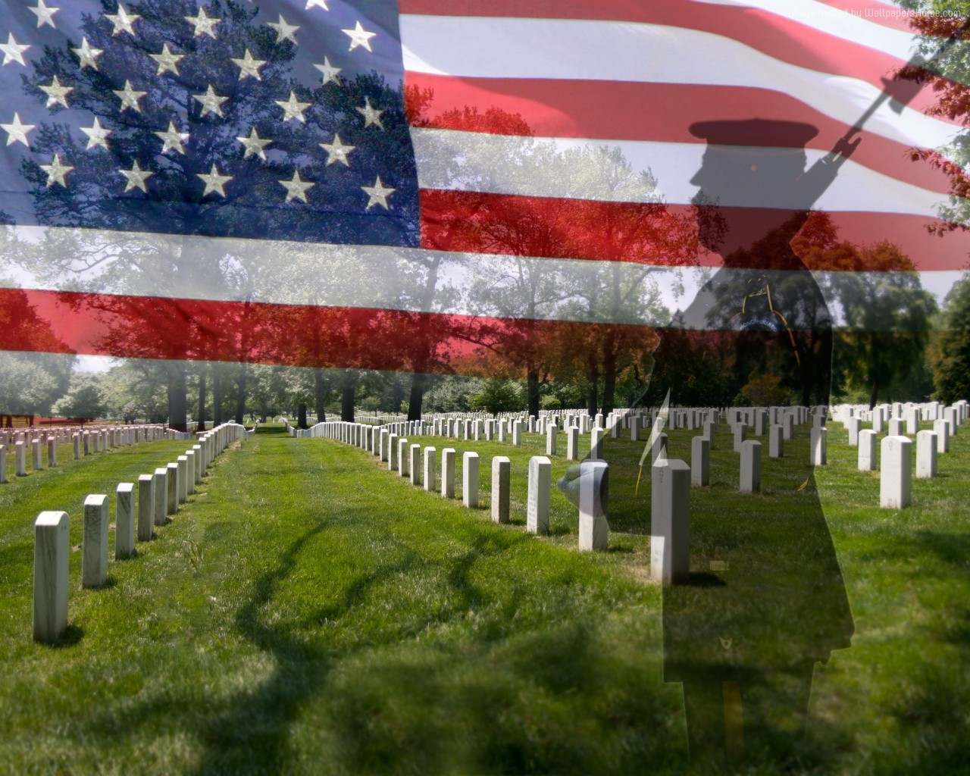
image courtesy of wallpapershome.com

Slide 2
Matthew 5.39, 44-45 NIV: “But I tell you, do not resist an evil person. If anyone slaps you on the right cheek, turn to them the other cheek also… But I tell you, love your enemies and pray for those who persecute you, that you may be children of your Father in heaven.”

Slide 3
Luke 22.35-36 NIV: Then Jesus asked them, “When I sent you without purse, bag or sandals, did you lack anything?” “Nothing,” they answered. He said to them, “But now if you have a purse, take it, and also a bag; and if you don't have a sword, sell your cloak and buy one.”

Slide 4
Matthew 5.9 NET: “Blessed are the peacemakers, for they will be called the children of God.”

Slide 5
image courtesy of wallpapershome.com

Slide 6
Isaiah 9.6-7 NIV: For to us a child is born, to us a son is given, and the government will be on his shoulders. And he will be called Wonderful Counselor, Mighty God, Everlasting Father, Prince of Peace. Of the greatness of his government and peace there will be no end. He will reign on David's throne and over his kingdom, establishing and upholding it with justice and righteousness from that time on and forever. The zeal of the LORD Almighty will accomplish this.

Slide 7
Romans 13.4-5 NIV: For the one in authority is God's servant for your good. But if you do wrong, be afraid, for rulers do not bear the sword for no reason. They are God's servants, agents of wrath to bring punishment on the wrongdoer. Therefore, it is necessary to submit to the authorities, not only because of possible punishment but also as a matter of conscience.

Slide 8
Luke 3.14 NET: He told them, “Take money from no one by violence or by false accusation, and be content with your pay.”

Slide 9
Judges 6.34-35 NIV: Then the Spirit of the LORD came on Gideon, and he blew a trumpet, summoning the Abiezrites to follow him. He sent messengers throughout Manasseh, calling them to arms…

Slide 10
Joshua 5.13-15 NIV: Now when Joshua was near Jericho, he looked up and saw a man standing in front of him with a drawn sword in his hand. Joshua went up to him and asked, “Are you for us or for our enemies?” “Neither,” he replied, “but as commander of the army of the LORD I have now come.” Then Joshua fell facedown to the ground in reverence, and asked him, “What message does my Lord have for his servant?” The commander of the LORD's army replied, “Take off your sandals, for the place where you are standing is holy.” And Joshua did so.

Slide 11
Isaiah 40.10 NET: Look, the sovereign LORD comes as a victorious warrior; his military power establishes his rule.

Slide 12
Revelation 19.11-21 NIV: I saw heaven standing open and there before me was a white horse, whose rider is called Faithful and True. With justice he judges and wages war. His eyes are like blazing fire, and on his head are many crowns. He has a name written on him that no one knows but he himself. He is dressed in a robe dipped in blood, and his name is the Word of God. The armies of heaven were following him, riding on white horses and dressed in fine linen, white and clean.

Slide 13
Coming out of his mouth is a sharp sword with which to strike down the nations. He will rule them with an iron scepter. He treads the winepress of the fury of the wrath of God Almighty. On his robe and on his thigh he has this name written: KING OF KINGS AND LORD OF LORDS. And I saw an angel standing in the sun, who cried in a loud voice to all the birds flying in midair, “Come, gather together for the great supper of God, so that you may eat the flesh of kings, generals, and the mighty, of horses and their riders, and the flesh of all people, free and slave, great and small.”

Slide 14
Then I saw the beast and the kings of the earth and their armies gathered together to wage war against the rider on the horse and his army. But the beast was captured, and with it the false prophet who had performed the signs on its behalf. With these signs he had deluded those who had received the mark of the beast and worshiped its image. The two of them were thrown alive into the fiery lake of burning sulfur. The rest were killed with the sword coming out of the mouth of the rider on the horse, and all the birds gorged themselves on their flesh.

Slide 15
image courtesy of wallpapershome.com

Slide 16
Acts 7.52 NET: “Which of the prophets did your ancestors not persecute? They killed those who foretold long ago the coming of the Righteous One, whose betrayers and murderers you have now become!”

Slide 17
image courtesy of wallpapershome.com

